Slide 1
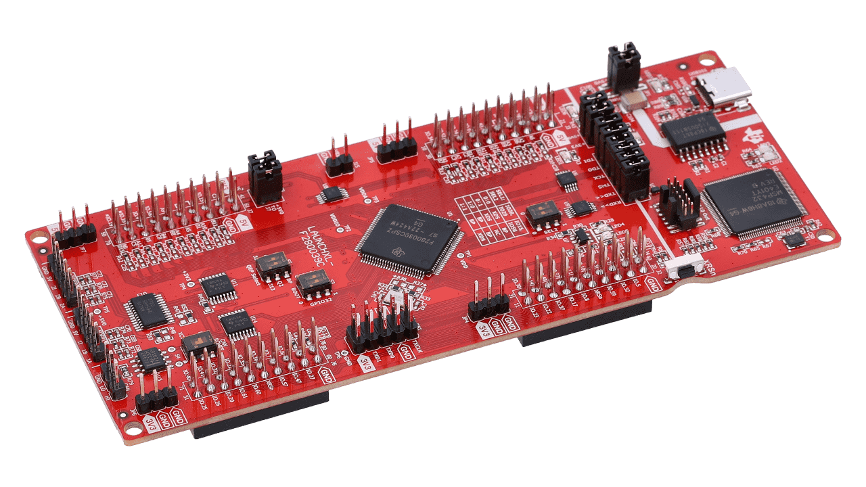

Team 1: ADC Resolution vs. Sensorless Motor Control Performance
Bi-Weekly Update 3 Cristian Ornelas, Tyler Hawkins, Tamara Basfar, John King Sponsor: Kevin Allen (Texas Instruments) TA: Fahrettin Ay
Notes:
Intro should take 30 seconds

Slide 2
Project Summary
Problem: How do different configurations of sensorless motor control affect performance?
Solution: Port the universal motor control software to one of TI’s newest c2000 devices. Develop updated configurations of the universal solution, and test the effects on sensorless control performance.
Notes:
Kyle

Slide 4
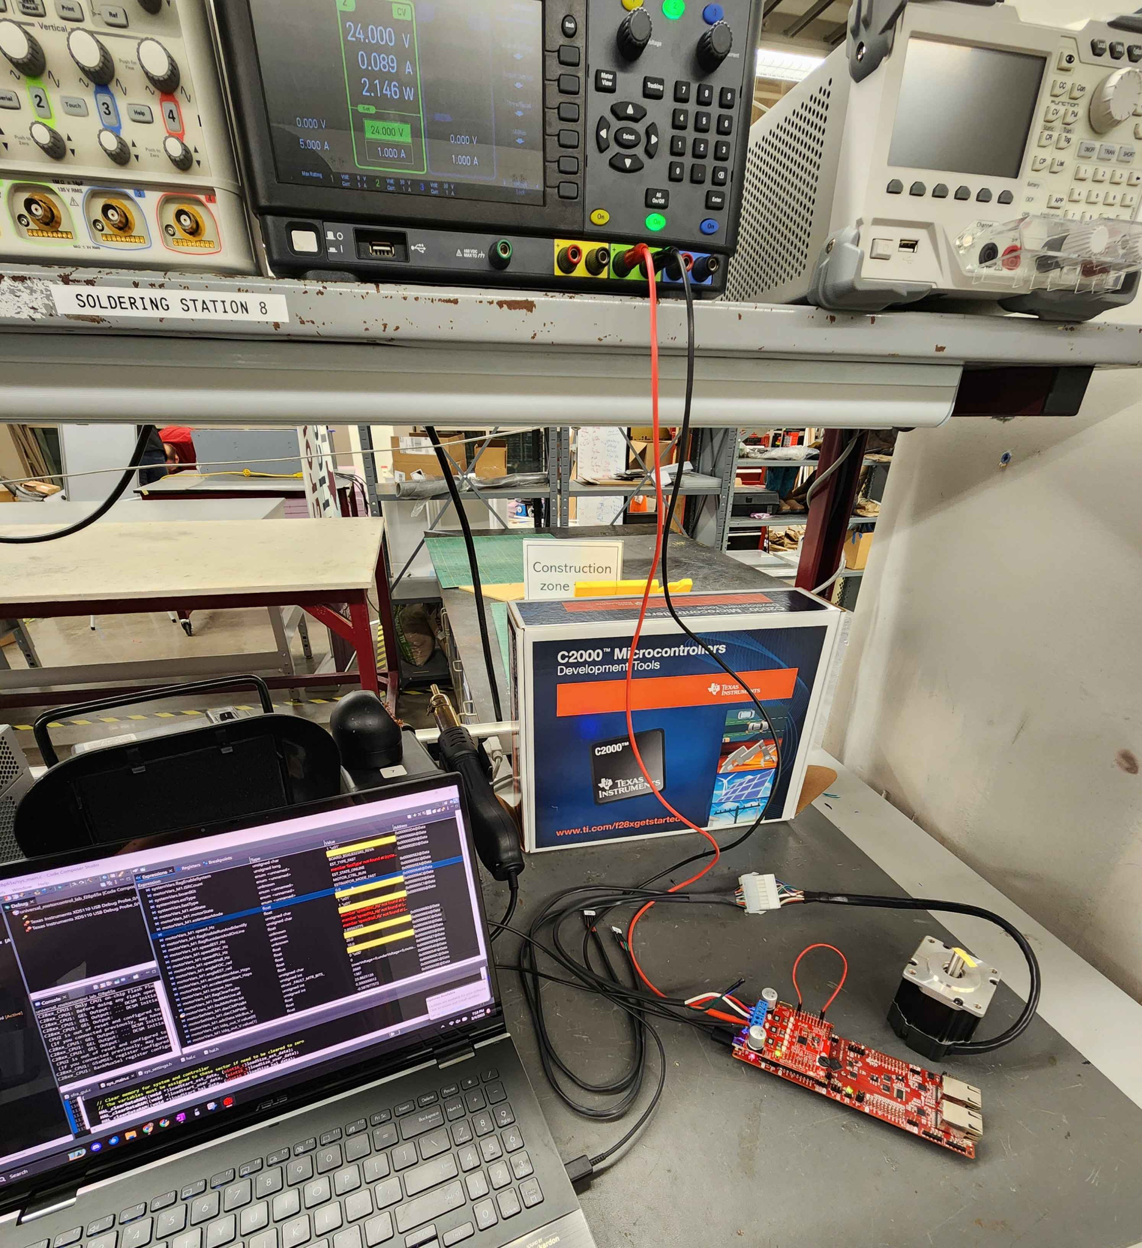
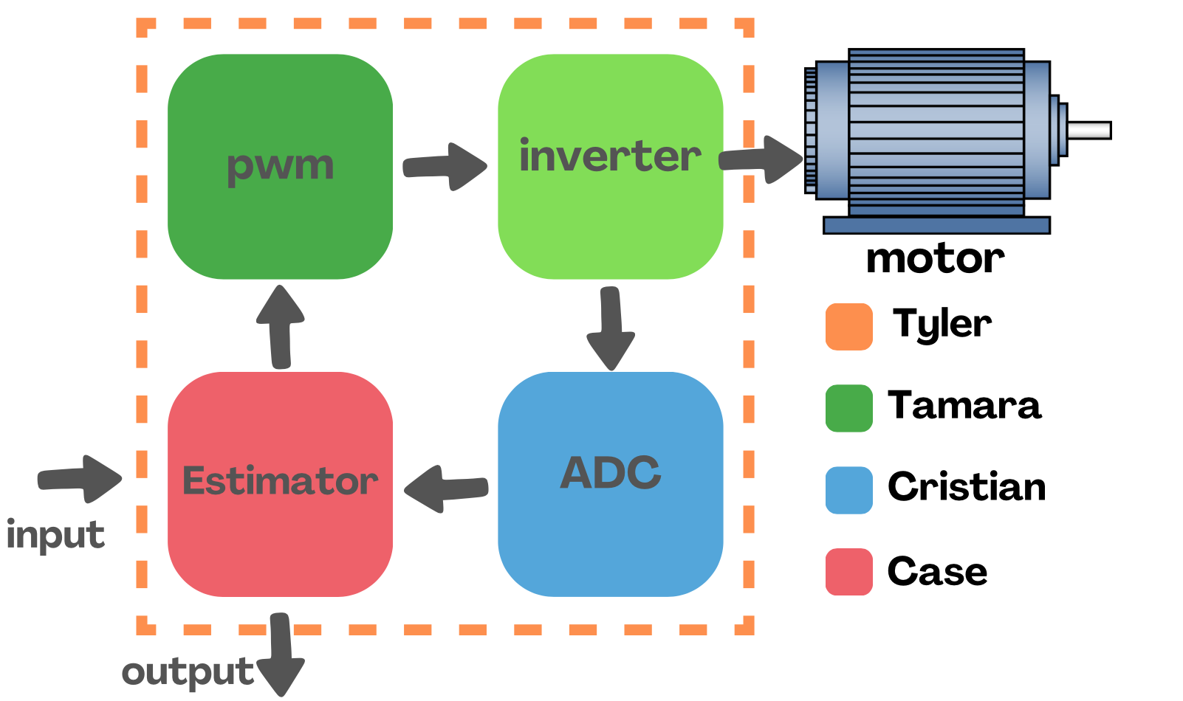
Project/Subsystem Overview
Notes:
Eric

Slide 5
Project Timeline
Port motor control solution to F28P65x Board (completed 1/30) | Modify software to enable data capture (to complete by 2/20) | Modify software for ADC resolution (12/16) bit (to complete by 3/6) | Modify software to run using 32/64 bit floating point (to complete by 3/6) | Modify software to enable oversampling (to complete by 3/6) | Test full software compatibility (to complete by 3/24) | Full system Validation/ testing (to complete by 3/27) | Demo and Report (to complete by 4/21)
Notes:
-- Save discussion for subsystem update
-- Save detail for execution plan & validation plan status

Slide 6
Floating Point Values
Case King
Accomplishments since last update 31 hrs of effort | Ongoing progress/problems and plans until the next presentation
All files within the float64 code compile properly. | There are still problems in the linkage files that need to be worked out.

Slide 7
12/16 Bit ADC Resolution
Cristian Ornelas
Accomplishments since last update 25 hrs of effort | Ongoing progress/problems and plans until the next presentation
16-bit ADC resolution runs with no compiling errors. | The ADC voltage shows a value of 1V instead of the external 24V that the power supply outputs. Once the 16-bit ADC resolution is completely implemented, I will run tests on the motor to show the difference in performance for both 12 and 16-bit ADC resolution.

Slide 8
Oversampling
Tamara Basfar
Accomplishments since last update 20 hrs of effort | Ongoing progress/problems and plans until the next presentation
developed an oversampling example from scratch for debugging. Because of challenges faced when trying to enable it in the final solution tested isolated example | Integrate working example into first version of the solution begin testing solution with oversampling enabled

Slide 9
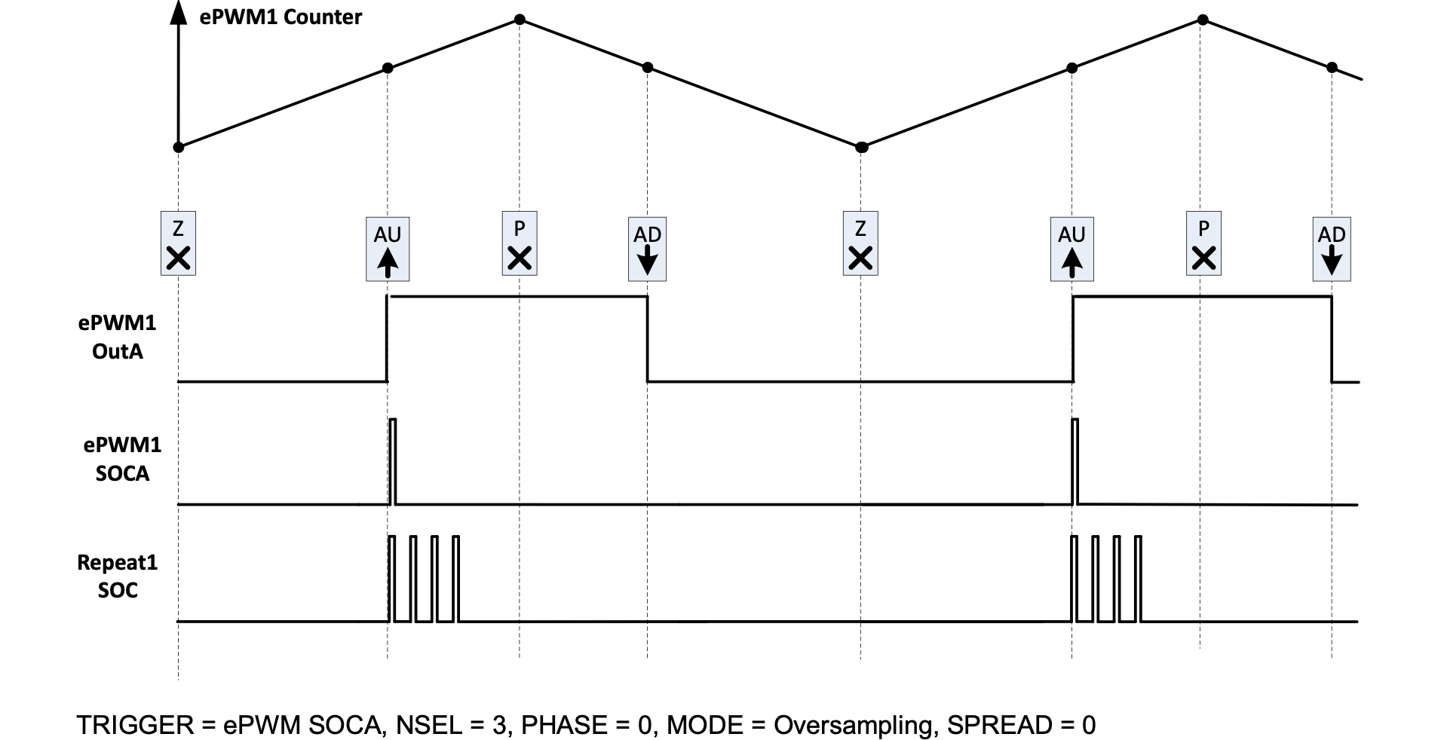

Slide 10
Test Data Acquisition
Tyler Hawkins
Accomplishments since last update 21 hrs of effort | Ongoing progress/problems and plans until the next presentation
-Developed Data Collection method capable of being toggled on/off during testing -Designed Motor mount to test motor load performance | -Weird Limit on # of data points -Work out kinks in data collection & enable more data points to be acquired -Finish final tweaks of motor mount and 3D print/assemble

Slide 11
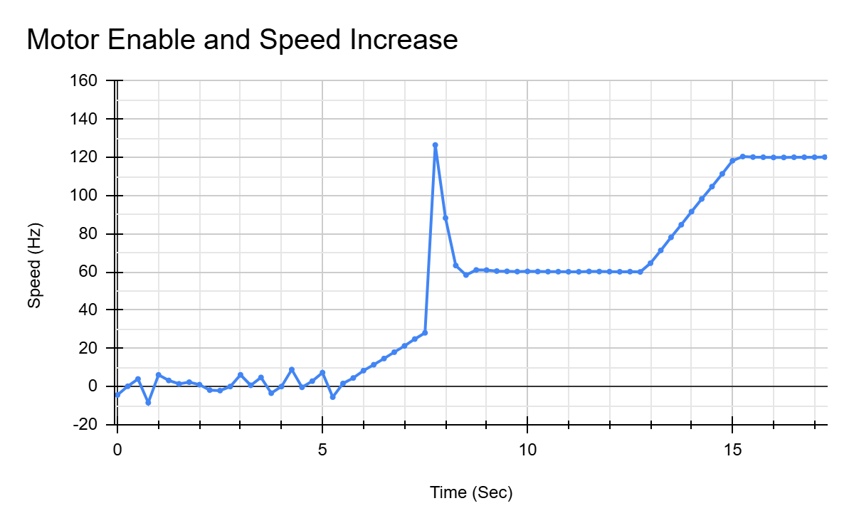

Slide 12
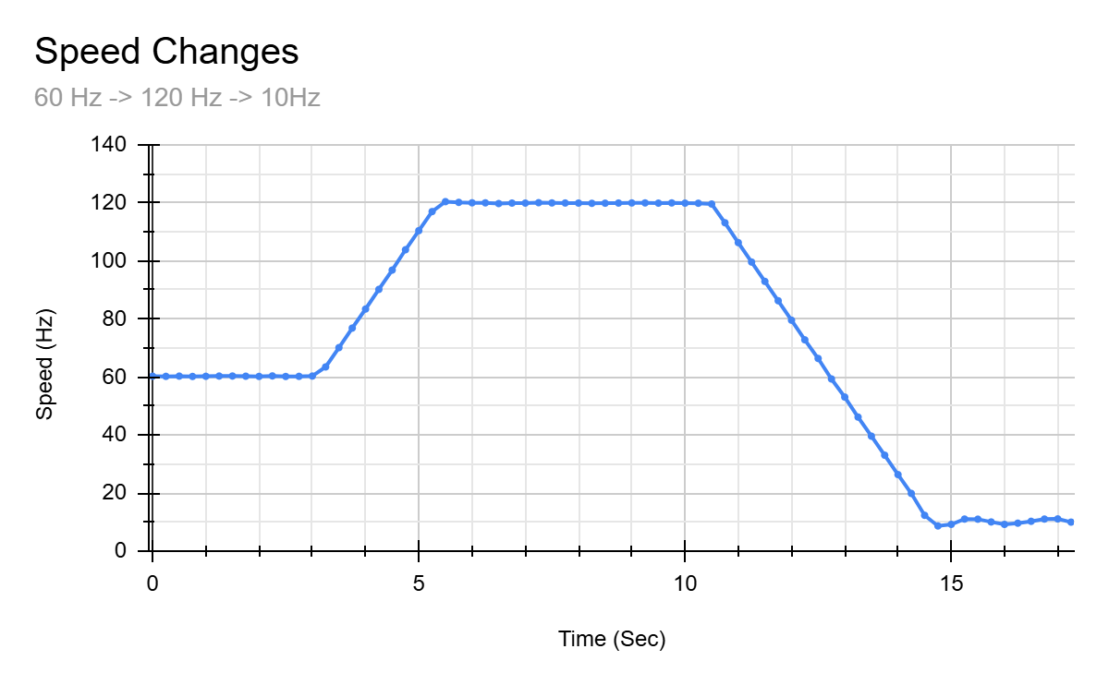

Slide 13
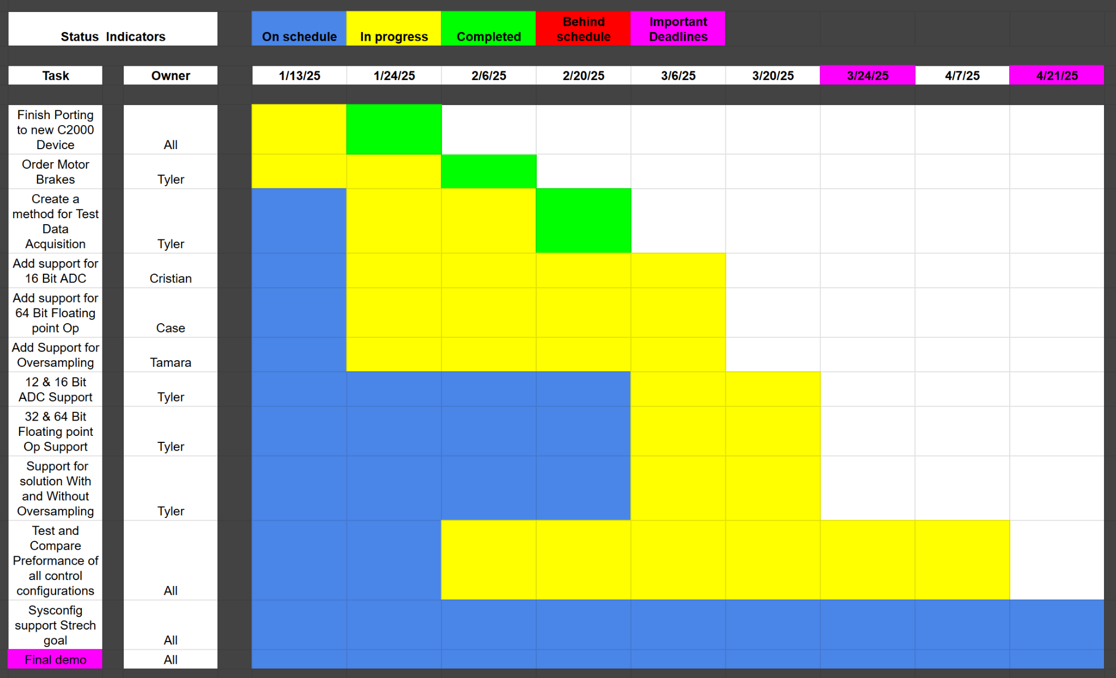
Execution Plan
Notes:
Michelle

Slide 14
Validation Plan
Task | Specification | Result | Owner
Porting Solution onto F28p65x board | Ported motor control software onto f28p65x board successfully according to the Universal Motor control guide | PASSED | All
16 Bit ADC resolution | The system correctly operates using 16-bit ADC resolution according to The Universal Motor control guide | UNTESTED | Cristian
64-bit Floating point operation | The system Correctly Operates using 64-bit Floating Point according to The Universal Motor control guide | UNTESTED | Case
Enable oversampling | The system Correctly Operates while oversampling is enabled according to The Universal Motor control guide | UNTESTED | Tamara
12 Bit & 16 Bit ADC resolution Support | The system correctly operates using either 12-bit or 16-bit ADC resolutions according to The Universal Motor control guide | UNTESTED | Cristian

Slide 15
Validation Plan
Task | Specification | Result | Owner
32-bit & 64-bit Floating point operation | The system Correctly Operates using either 32-bit or 64-bit Floating Point according to The Universal Motor control guide | UNTESTED | Tyler
Test data acquisition | The system Correctly gathers test data for the following parameters: speed ripple, speed step, and load step. Able to be graphed and differences should be able to be seen. | Passed But Needs Improvements for better data | Tyler
Test 12 vs 16 Bit performance | Test the performance of 12-bit and 16-bit ADC resolutions: speed ripple, speed step, load step. | UNTESTED | Cristian
Test 32-bit & 64-bit Floating-point performance | Test the performance of 32-bit and 64-bit ADC Floating point operations: speed ripple, speed step, load step. | UNTESTED | Case
Test the performance of oversampling | Test the effectiveness of oversampling: speed ripple, speed step, load step. | UNTESTED | Tamara

Slide 16
Thanks & Gig’em
Team 1: ADC Resolution vs. Sensorless Motor Control Performance

